Slide 1
WALK THROUGH OF THE NATIONAL RTCQI & CLI PROGRAMME – CLI SUPPORT
Ms A Marsh: Deputy Director: HTS Program Manager

Slide 2
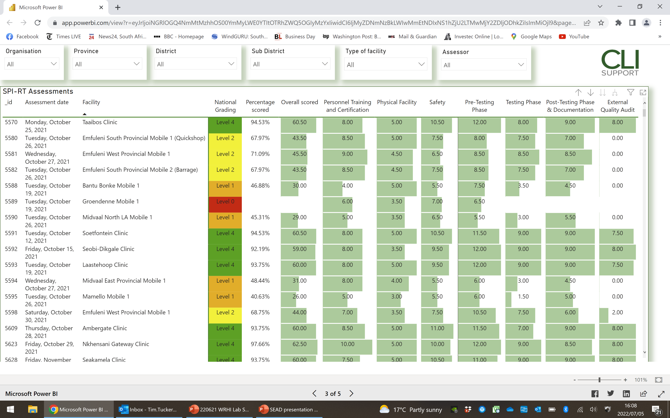
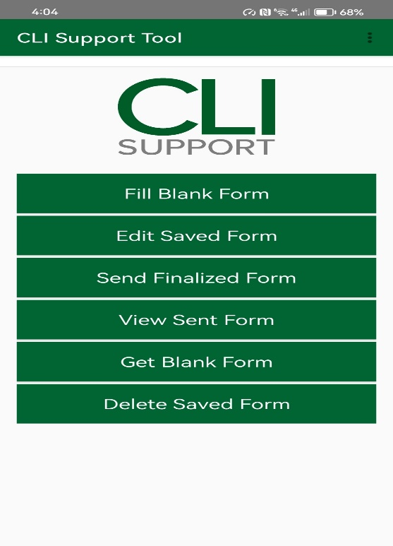

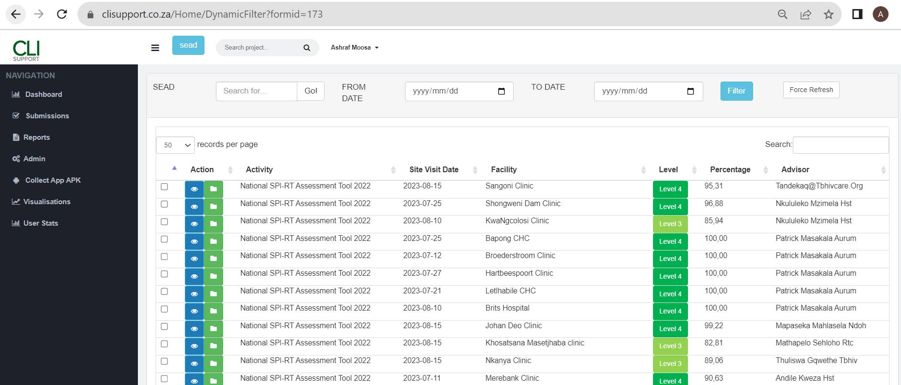
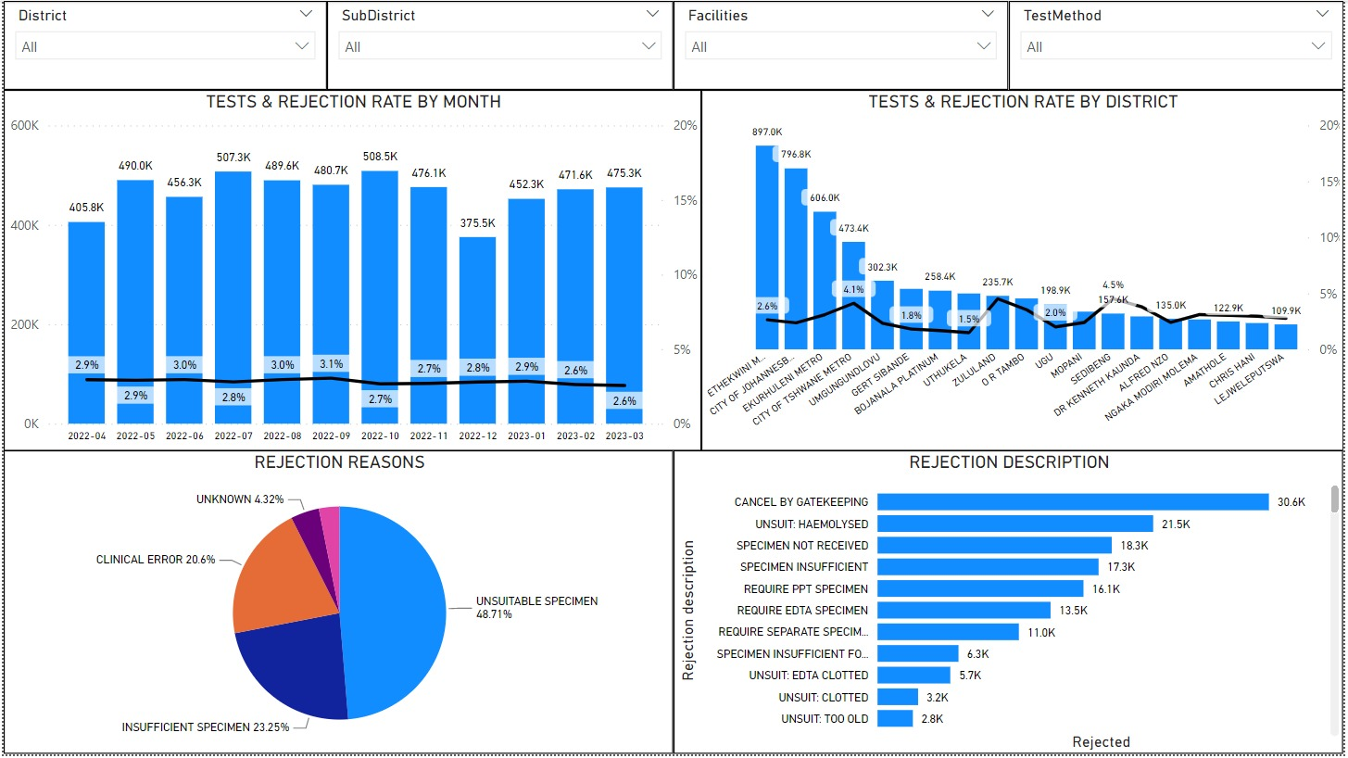
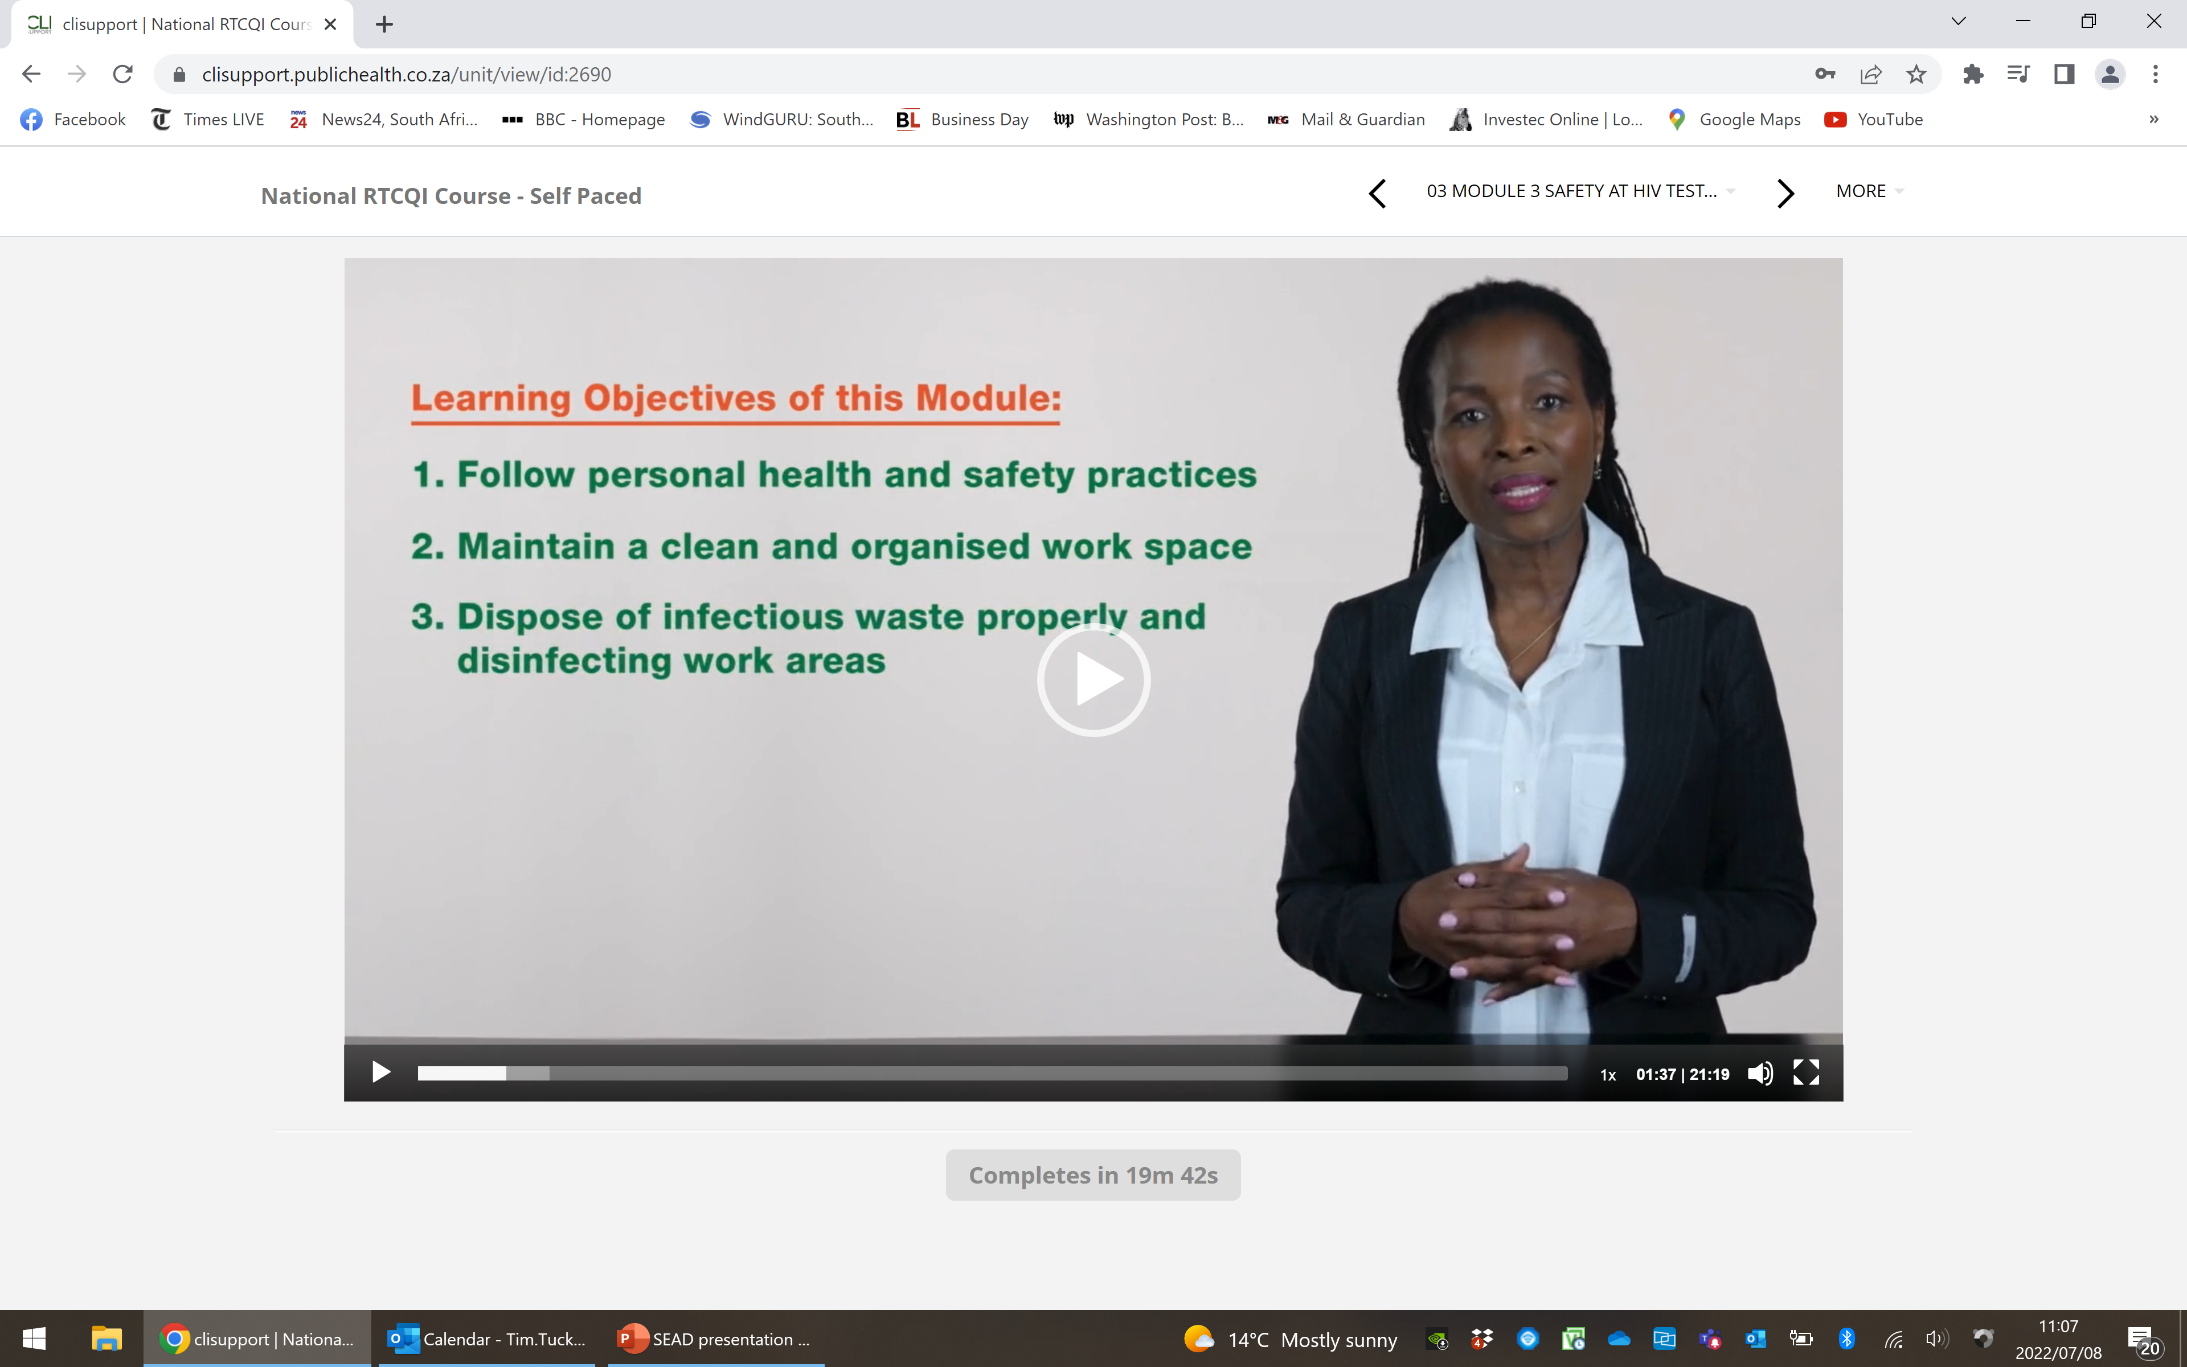
OVERVIEW: THE NATIONAL CLI SUPPORT PLATFORM
Monitoring and reporting
Learning Management System
TA Practitioner apps

Slide 3

USE FOR THE CLI SUPPORT PLATFORM
USED BY
Currently: Full RTCQI and CLI national programmes
Future: Platform can enhance the rollout of any DOH mandated QA or HSS initiative
NDOH
ANOVA
AURUM
BROADREACH
HST
MATCH
RIGHT TO CARE
SA PARTNERS
TB HIV CARE
WRHI
DCS
Users DOH: 600+
Users DSPs: 600+

Slide 4
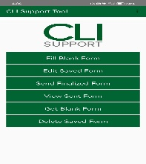


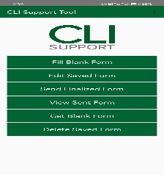

CLI SUPPORT - USER JOURNEY
Assessment / Audit
Analysis, reporting
Intervention design
Intervention
M&E

Slide 5
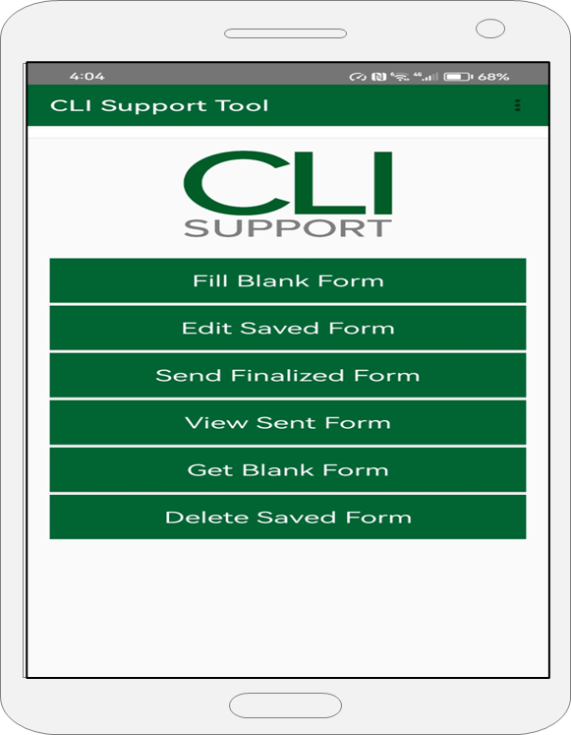
STEP 1: DOWNLOAD AND INSTALL CLI SUPPORT APP
Download via link:
  Enter the link address in your web browser
    https://clisupport.co.za/Home/Download
Install directly from App Store (In progress)

Slide 6
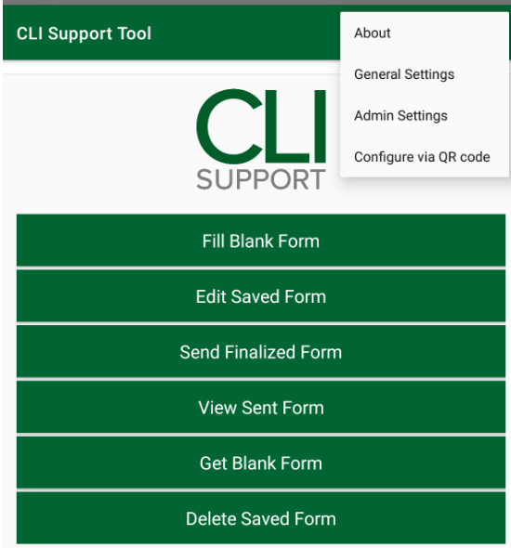
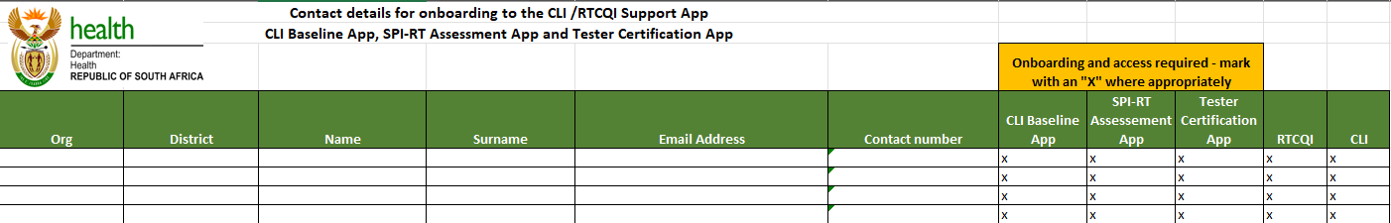
STEP 2: APPLICATION SETUP
User details and roles defined before on-boarding
User credentials, server settings and app preferences set

Slide 7

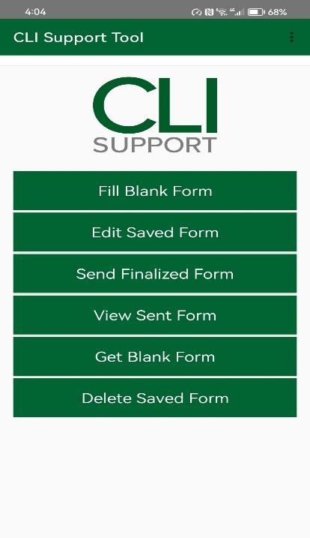
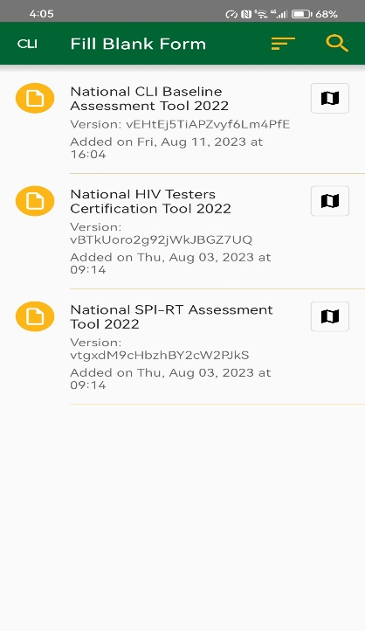
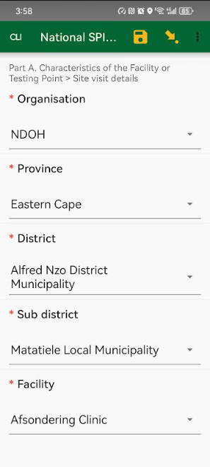
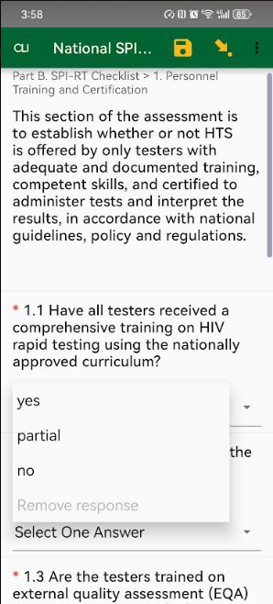
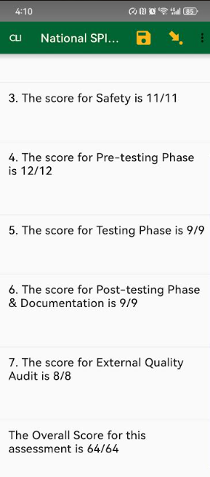
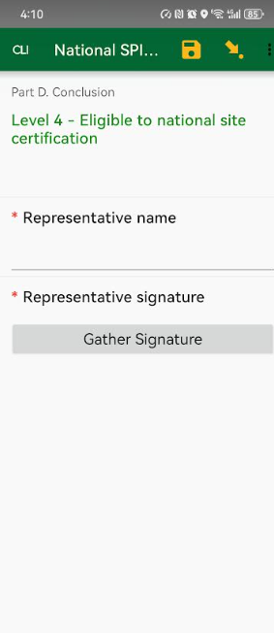
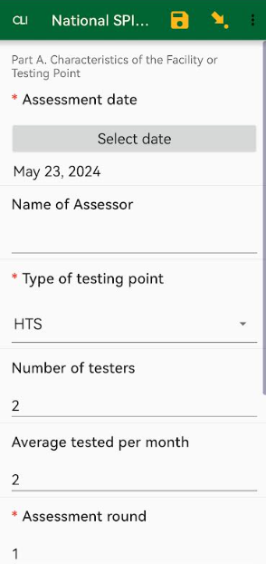
STEP 3: USER SUBMISSIONS

Slide 8
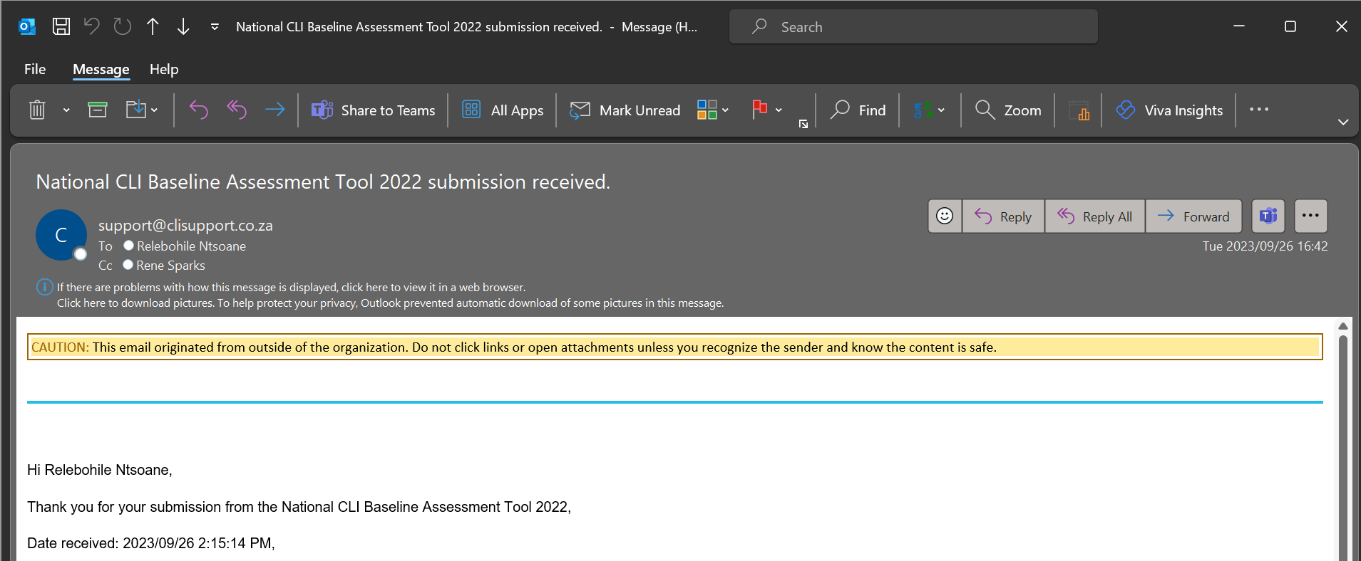

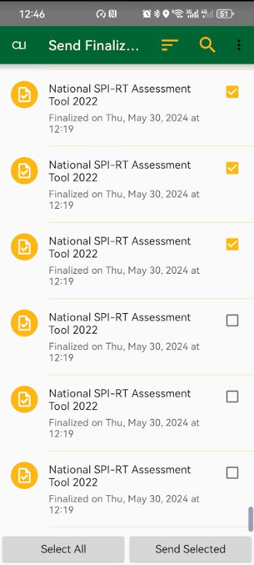
STEP 4: EMAIL CONFIRMATION

Slide 9
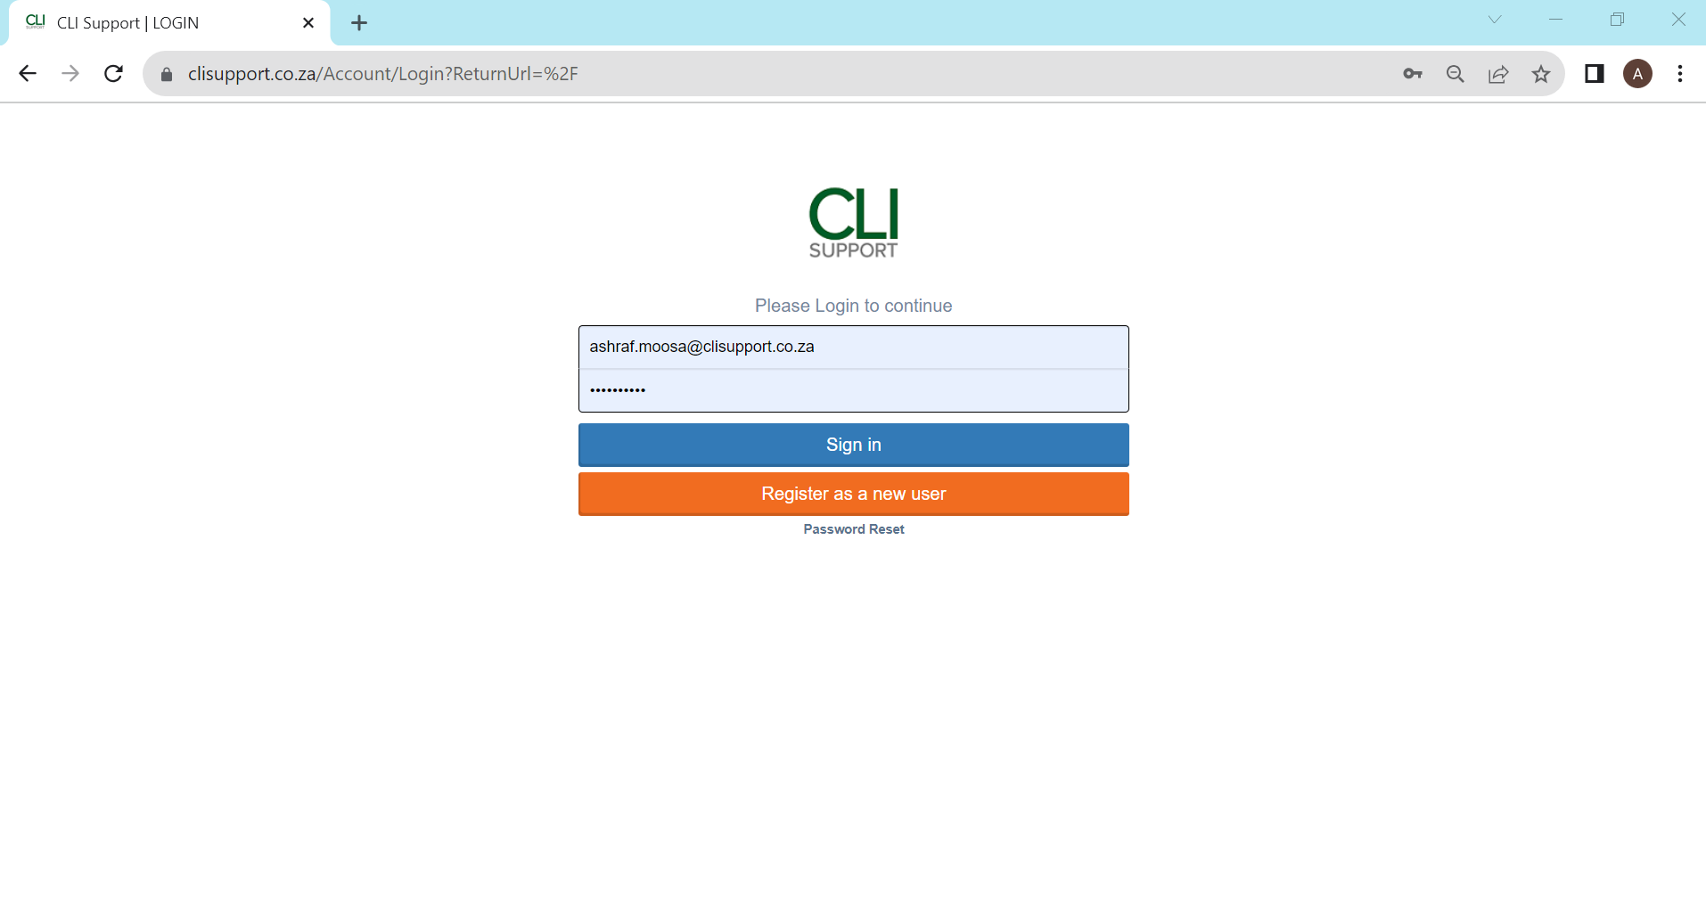

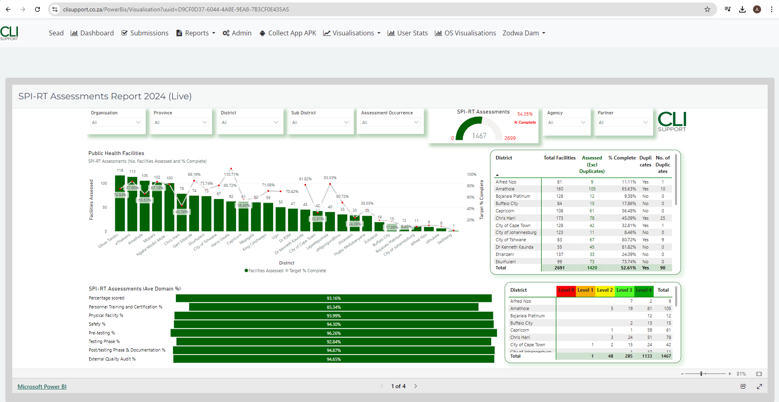
STEP 5 ACCESS SUBMISSIONS, REPORTS AND VISUALISATIONS VIA WEB PORTAL

Slide 10

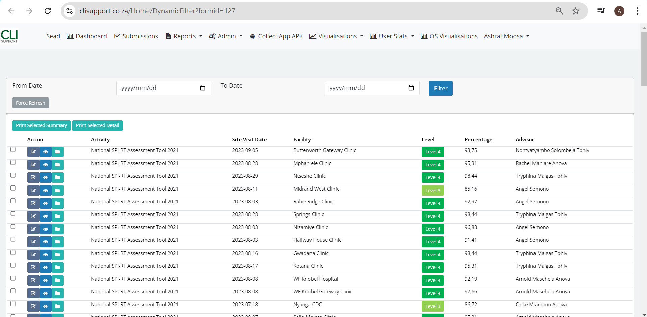
6. LISTS OF SUBMISSIONS VISIBLE

Slide 11


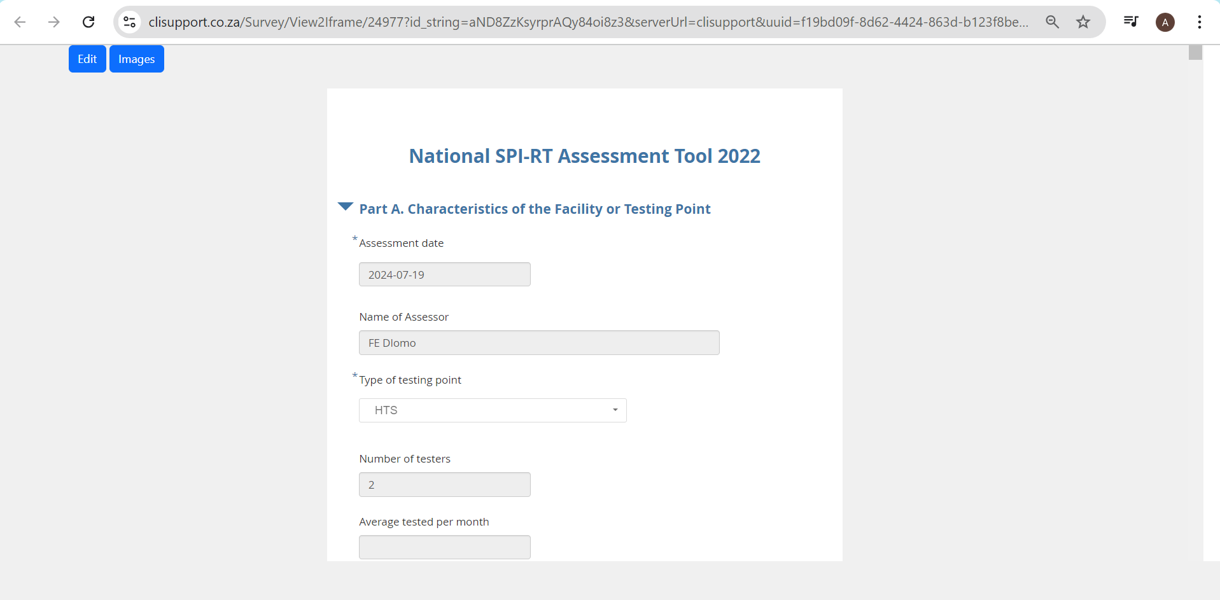
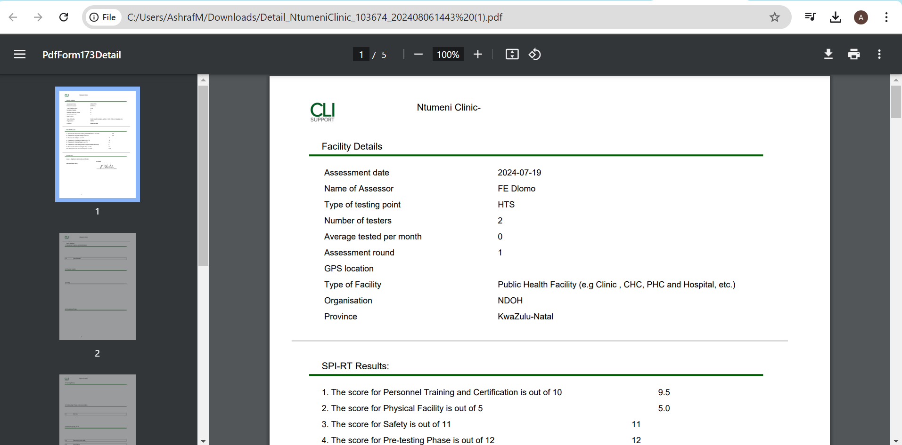
7. EDITING SUBMISSIONS AND PRINTING PDFs
View and edit submissions
Download PDF reports

Slide 12

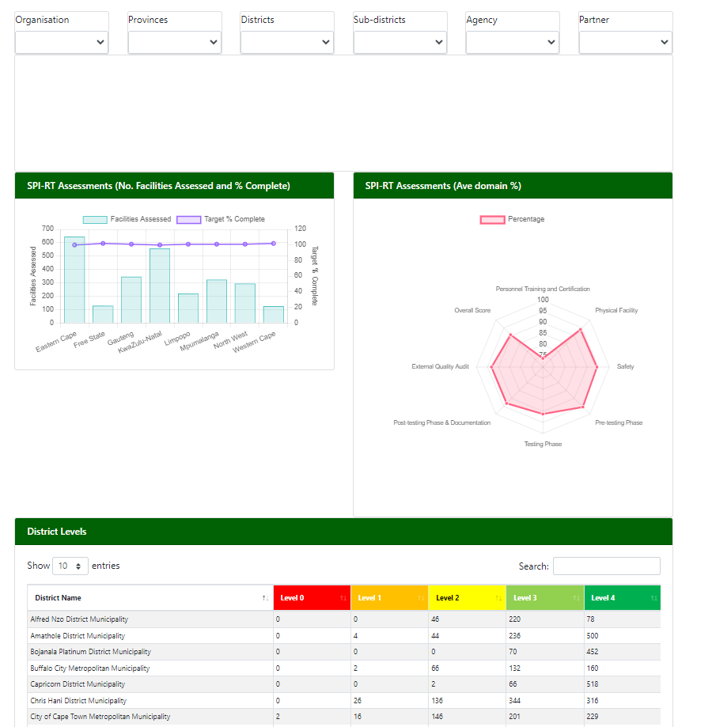
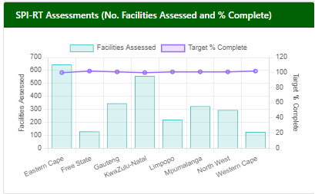
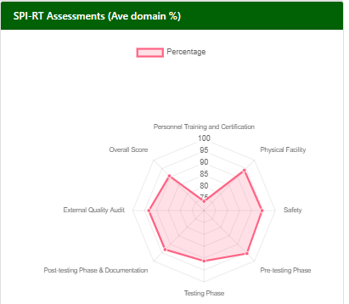
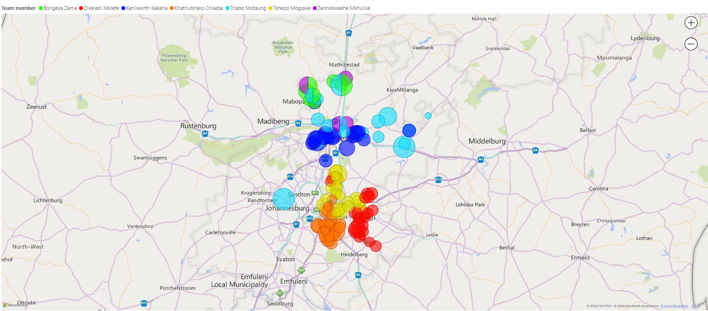
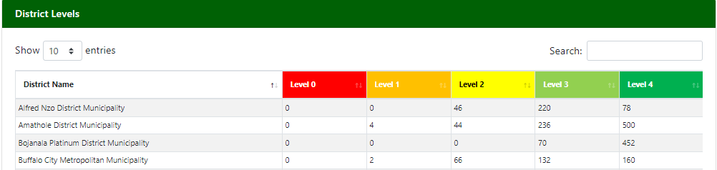
8. USER VIEWS REPORTS AND VISUALIZATIONS, REVIEWING
PROGRESS AND PLANNING ACTIVITIES (ASSESSMENTS/INTERVENTIONS)

Slide 13
9. LEARNING MANAGEMENT

Slide 14

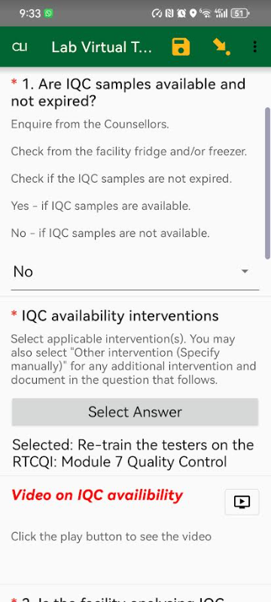
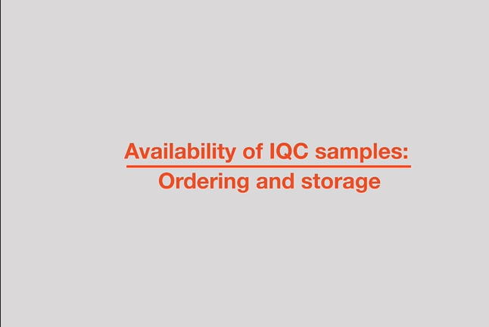

10. LEARNING MANAGEMENT TOOLS
    Intervention and learning management is becoming integrated

Slide 15
11. SYSTEM SPECIFICATIONS
Open-source
Platform agnostic / independent
Works offline
Accessible devices (Android) & laptop
Can be part of a hybrid system with paper-based legacy

Slide 16
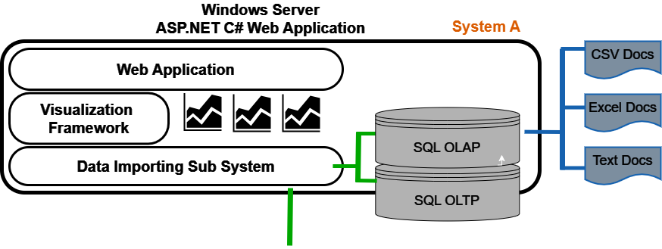
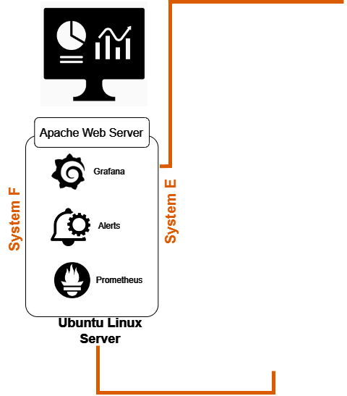
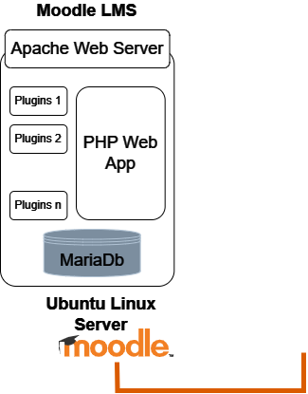
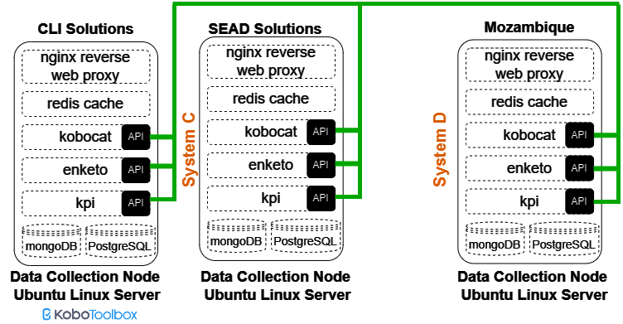

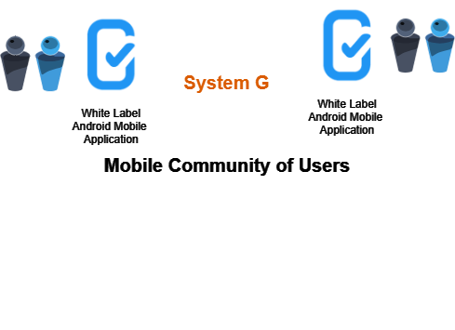
12. SYSTEM ARCHITECTURE
DoH Programme X
DoH Programme Y

Slide 17
13. INTEGRATION AND HANDOVER PLAN
1. Orientation: September to November 2024
Get to know the programme and system, work with it to see what works well for you and what you would like to change
2. Reconfigure: December to February 2025
Make adjustments to the programme and system based on feedback above
3. Full system handover: March to September 2025
Managed handover to DOH internal IT/preparation for external contractor

Slide 18

THANK YOU
SPECIAL THANKS TO
CDC, South Africa team
TB HIV/CARE

